Slide 1

Key facts about your topic
Founded: 2008
Revenue: $2.60 Billion USD (2017)
Headquarters: San Francisco, CA
CEO: Brian Chesky
Founders: Brian Chesky, Joe Gebbia, Nathan Blecharczyk
A‌i‌r‌b‌n‌b‌,‌ ‌I‌n‌c‌.‌ is an online marketplace for arranging or offering lodging, primarily homestays, or tourism experiences. The company does not own any of the real estate listings, nor does it host events; it acts as a broker, receiving commissions from each booking. The company is based in San Francisco, California, United States.
Notes:
QuickStarter has created an outline to help you get started on your presentation. Some slides include information here in the notes to provide additional topics for you to research.

Slide 2

Contents
Who is using Airbnb in NYC?
How is Airbnb used in the different boroughs?
How do house building projects affect their Airbnb use?
Does crime have an impact on the Airbnb's use in different boroughs?

Slide 3
The data exploration and cleanup process
#Check for duplicates abb_df.duplicated().sum()
0
#Check for Airbnb's availability for 2019 abb_df['availability_365'].value_counts().head()
0 17533 365 1295 364 491 1 408 361
#Drop Airbnb's with no availability for 2019 unavail_abb_df = abb_df[abb_df['availability_365']==0] clean_abb_df = abb_df[abb_d f['availability_365']>0] len(clean_abb_df)
31362

Slide 4
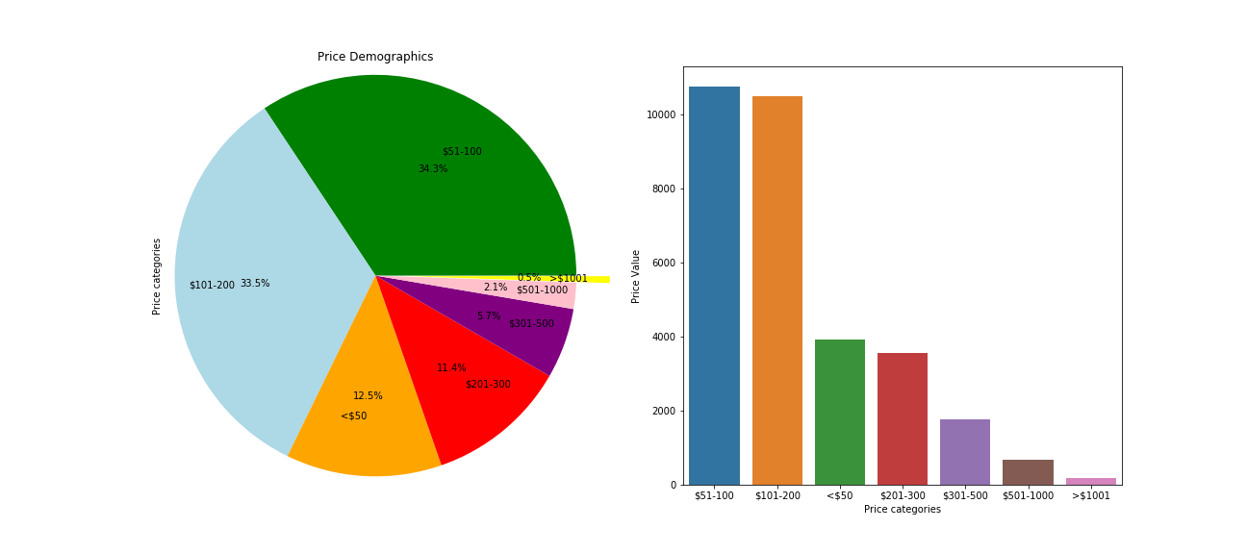
Who is using Airbnb in NYC ?
Minimum Price | Maximum Pirce | Mean
$0 | $10000 | $162.05

Slide 5
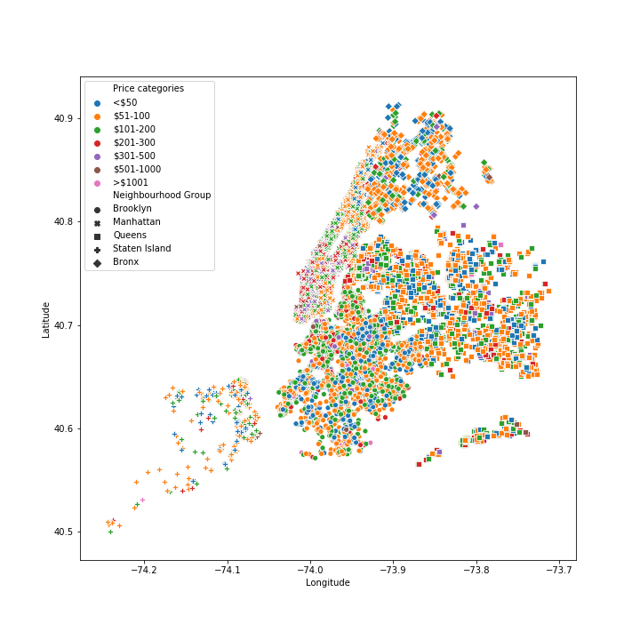

Slide 6
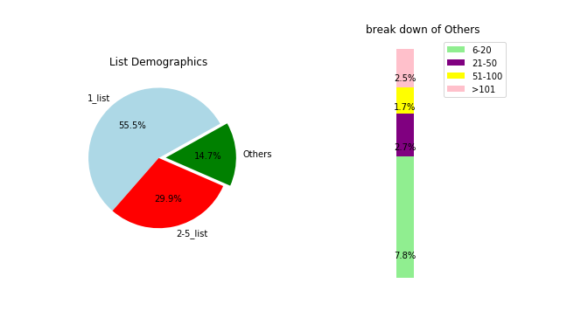

Slide 7

Works cited
2019 New York Airbnb Open Data (CSV) -
https://www.kaggle.com/dgomonov/new-
york-city-airbnb-open-data
NYC Population by Neighbourhood (CSV)-
https://data.cityofnewyork.us/City-
Government/New-York-City-Population-By-Neighborhood-Tabulatio/swpk-hqdp
Demographic and Housing Profiles by Borough (CSV) -
https://data.cityofnewyork.us/City-Government/Demographic-and-Housing-Profiles-
by-Borough/cu9u-3r5e
NYPD Arrest Data (Year-to-Date) (CSV) -
https://data.cityofnewyork.us/Public-
Safety/NYPD-Arrest-Data-Year-to-Date-/uip8-fykc
Tweepy (API)

